Slide 1
Information Retrieval
Subject Code: 23CST-618
Prepared by: DR. Manjit Singh

Slide 2
Course Objectives
Demonstrate genesis and diversity of information retrieval situations for text and hyper media.
Describe hands-on experience store, and retrieve information from www using semantic approaches.
Demonstrate the usage of different data/file structures in building computational search engines.
Analyze the performance of information retrieval using advanced techniques such as classification, clustering, and filtering over multimedia.
Analyze ranked retrieval of a very large number of documents with hyperlinks between them
Demonstrate Information visualization technologies like Cognition and perception in the Internet or Web search engine

Slide 3
Using language models (LMs) for IR
LM = language model
We view the document as a generative model that generates the query.
What we need to do:
Define the precise generative model we want to use
Estimate parameters (different parameters for each document’s model)
Smooth to avoid zeros
Apply to query and find document most likely to have generated the query
Present most likely document(s) to user
Note that x – y is pretty much what we did in Naive Bayes.

Slide 4
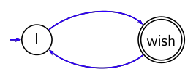
What is a language model?
We can view a finite state automaton as a deterministic language
model.
I wish I wish I wish I wish . . . Cannot generate: “wish I wish”
or “I wish I”. Our basic model: each document was generated by a different automaton like this except that these automata are probabilistic.
4

Slide 5
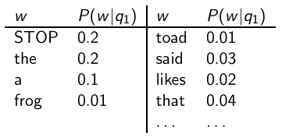

A probabilistic language model
This is a one-state probabilistic finite-state automaton – a unigram language model – and the state emission distribution for its one state q₁. STOP is not a word, but a special symbol indicating that the automaton stops. frog said that toad likes frog STOP
P(string) = 0.01 · 0.03 · 0.04 · 0.01 · 0.02 · 0.01 · 0.02
= 0.0000000000048
5

Slide 6
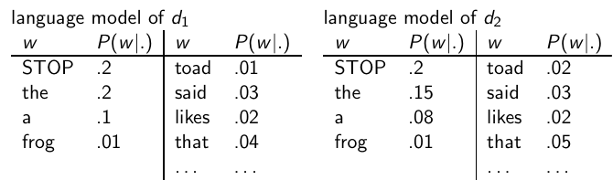
A different language model for each document
frog said that toad likes frog STOP P(string|M_{d1} ) = 0.01 · 0.03 · 0.04 · 0.01 · 0.02 · 0.01 · 0.02 = 0.0000000000048 = 4.8 · 10⁻¹²
P(string|M_{d2} ) = 0.01 · 0.03 · 0.05 · 0.02 · 0.02 · 0.01 · 0.02 = 0.0000000000120 = 12 · 10⁻¹² P(string|M_{d1} ) < P(string|M_{d2} )
Thus, document d₂ is “more relevant” to the string “frog said that toad likes frog STOP” than d₁ is.
6

Slide 7

Using language models in IR
Each document is treated as (the basis for) a language model.
Given a query q
Rank documents based on P(d|q)
P(q) is the same for all documents, so ignore
P(d) is the prior – often treated as the same for all d
But we can give a prior to “high-quality” documents, e.g., those with high PageRank.
P(q|d) is the probability of q given d.
So to rank documents according to relevance to q, ranking according to P(q|d) and P(d|q) is equivalent.
7

Slide 8
Where we are
In the LM approach to IR, we attempt to model the query generation process.
Then we rank documents by the probability that a query would be observed as a random sample from the respective document model.
That is, we rank according to P(q|d).
Next: how do we compute P(q|d)?
8

Slide 9


How to compute P(q|d)
We will make the same conditional independence assumption as for Naive Bayes.
(|q|: length ofr q; t_{k} : the token occurring at position k in q)
This is equivalent to:
tf_{t,q}: term frequency (# occurrences) of t in q
Multinomial model (omitting constant factor)

Slide 10
Text Books / Reference Books
T1 David A. Grossman, OphirFrieder, Information Retrieval – Algorithms and Heuristics, Springer, 2nd Edition( Distributed by Universal Press), 2004
REFERENCE BOOKS: R1 Gerald J Kowalski, Mark T Maybury Information Storage and Retrieval Systems: Theory and Implementation, Springer, 2004
R2 Soumen Chakrabarti, Mining the Web : Discovering Knowledge from Hypertext Data, Morgan – Kaufmann Publishers, 2002

